Slide 1
Federal Reserve Challenge NY 2016
Thomas Flannery Ronak Shah Timothy Leahey

Slide 2
Outlook
We see oil stabilizing at $65/barrel and as a result:
Gross private investment should increase therefore strengthening GDP growth
Core inflation should rise towards 2% target level
Increasing employment in the 25 – 54 year old bracket with wage growth demonstrates the strong demand for US workers
Unemployment will continue to decline at the same pace through 2017
We believe the Federal Reserve should increase rates by 150 basis points
in increments of 25 bps throughout 2017 & 2018
Source: Bureau of Labor Statistics, Team Projections
2

Slide 3
Inflation Forecast
Dual mandate inflation target of 2% is based on Core PCE
We are forecasting headline inflation to revert towards its historical relationship with Core PCE
Headline PCE inflation (December 2018) to be 2.2%
Core PCE Inflation in line with FOMC forecast
PCE vs CPI Historical Relationship
Percent Change (%)
PCE CYOY Index CPI YOY Index
6
Headline PCE vs. Core PCE
Percent Change (%)
Core PCE PCE: All Items FOMC Forecast Our Headline Forecast
5.0
5
4.0
4
3.0
3
2
2.0
1
1.0
0
0.0
-1
-2
-1.0
-3
Jan-00
Jul-00 Jan-01 Jul-01 Jan-02 Jul-02 Jan-03 Jul-03 Jan-04 Jul-04 Jan-05 Jul-05 Jan-06 Jul-06 Jan-07 Jul-07 Jan-08 Jul-08 Jan-09 Jul-09 Jan-10 Jul-10 Jan-11 Jul-11 Jan-12 Jul-12 Jan-13 Jul-13 Jan-14 Jul-14 Jan-15 Jul-15 Jan-16 Jul-16
-2.0
Jan-00
Jul-00 Jan-01 Jul-01 Jan-02 Jul-02 Jan-03 Jul-03 Jan-04 Jul-04 Jan-05 Jul-05 Jan-06 Jul-06 Jan-07 Jul-07 Jan-08 Jul-08 Jan-09 Jul-09 Jan-10 Jul-10 Jan-11 Jul-11 Jan-12 Jul-12 Jan-13 Jul-13 Jan-14 Jul-14 Jan-15 Jul-15 Jan-16 Jul-16 Jan-17 Jul-17 Jan-18 Jul-18
Source: Federal Reserve Bank of St. Louis (FRED)
Source: Federal Reserve Bank of St. Louis (FRED), Team Forecasts
3

Slide 4
Expansionary Monetary Policy = Inflation growth?
Growth of money supply post Great Recession has been consistently 4-6% higher than inflation growth
M2 growth has been spurred by low interest rate policy set by the FOMC
Monetary Supply Growth vs. CPI Growth
Percent Growth (%) | Interest Rate (bps)
Monetary Supply (M2) CPI: All Items Effective Fed Funds Rate
12.0 600
10.0
500
8.0
400
6.0
4.0 300
2.0
200
0.0
100
-2.0
-4.0 0
Jul-06
Nov-06 Mar-07 Jul-07 Nov-07 Mar-08 Jul-08 Nov-08 Mar-09 Jul-09 Nov-09 Mar-10 Jul-10 Nov-10 Mar-11 Jul-11 Nov-11 Mar-12 Jul-12 Nov-12 Mar-13 Jul-13 Nov-13 Mar-14 Jul-14 Nov-14 Mar-15 Jul-15 Nov-15 Mar-16 Jul-16
Source: Federal Reserve Bank of St. Louis (FRED)
4

Slide 5
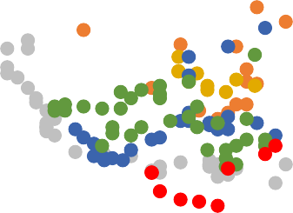
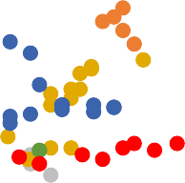
Time to Ditch the Phillips Curve?
Inflation vs. Unemployment
1960-1969 1970-1979 1980-1989
16.0
14.0
12.0
10.0
8.0
6.0
4.0
2.0
0.0
-2.0
-4.0
1990-1999
2000-2008
2009-Present
Inflation (%)
0.0
2.0 4.0
6.0 8.0 10.0 12.0
Unemployment (%)
Source: Federal Reserve Bank of St. Louis (FRED)
The widely used relationship is no longer reliable
Correlation is actually positive since the end of the Great Recession
5

Slide 6
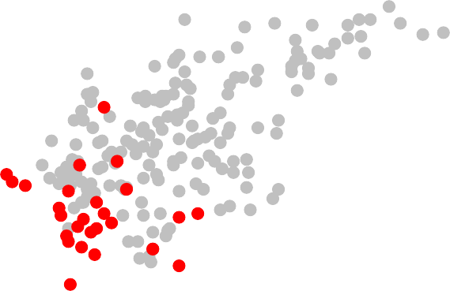
Non Farm Payrolls - Wage Growth
Wage Growth vs. CPI
1960-2009 2009-2016
14.0
12.0
10.0
8.0
6.0
4.0
2.0
0.0
-2.0
Wage Growth (%)
-4.0 -2.0 0.0
Source: Federal Reserve Bank of St. Louis (FRED)
2.0
4.0
6.0
Inflation (%)
8.0
10.0
12.0
14.0
16.0
1960-Present Correlation: 0.79
2009-Present Correlation: 0.04
6

Slide 7
All Sources: Federal Reserve Bank of St. Louis (FRED)
Jan-06 Jun-06 Nov-06 Apr-07 Sep-07
Feb-08 Jul-08 Dec-08 May-09 Oct-09 Mar-10 Aug-10 Jan-11 Jun-11 Nov-11 Apr-12 Sep-12
Feb-13 Jul-13 Dec-13 May-14 Oct-14 Mar-15 Aug-15 Jan-16 Jun-16
-2.0
-1.0
0.0
1.0
2.0
3.0
4.0
5.0
Jan-06 Jun-06 Nov-06 Apr-07 Sep-07
Feb-08 Jul-08 Dec-08 May-09 Oct-09 Mar-10 Aug-10 Jan-11 Jun-11 Nov-11 Apr-12 Sep-12
Feb-13 Jul-13 Dec-13 May-14 Oct-14 Mar-15 Aug-15 Jan-16 Jun-16
-20.0
-15.0
-10.0
-5.0
0.0
5.0
10.0
15.0
20.0
Reaching the FOMC Target/Forecast?
PCE
Percentage Change YoY (%)
Aggregate Inflation Indicators
Percentage Change YoY (%)
PCE
PCE
FOMC Target Rate
CPI: All Consumers
PPI: All Commodities
FOMC Target Rate
Jan-06 Jun-06 Nov-06 Apr-07 Sep-07
Feb-08 Jul-08 Dec-08 May-09 Oct-09 Mar-10 Aug-10 Jan-11 Jun-11 Nov-11 Apr-12 Sep-12
Feb-13 Jul-13 Dec-13 May-14 Oct-14 Mar-15 Aug-15 Jan-16 Jun-16
-20.0
-15.0
-10.0
-5.0
0.0
5.0
10.0
15.0
20.0
Jan-06 Jun-06 Nov-06 Apr-07 Sep-07
Feb-08 Jul-08 Dec-08 May-09 Oct-09 Mar-10 Aug-10 Jan-11 Jun-11 Nov-11 Apr-12 Sep-12
Feb-13 Jul-13 Dec-13 May-14 Oct-14 Mar-15 Aug-15 Jan-16 Jun-16
-3.0
-2.0
-1.0
0.0
1.0
2.0
3.0
4.0
5.0
6.0
PPI
Percentage Change YoY (%)
PPI: All Commodities
CPI
Percentage Change YoY (%)
CPI: All Consumers FOMC Target Rate CPI Forecasts (1 Year Lag)
FOMC Target Rate
7

Slide 8


Held Back by Energy?
Inflation Indicators with Stable Counterparts
Percentage Change YoY (%)
PCE: All Items CPI: All Items PCE: Less Food and Energy CPI: Less Food and Energy
Energy is a major component of headline inflation, but can provide a significant amount of volatility as well
Removing energy for core inflation computations puts indicators much closer to the FOMC inflation target
6
5
4
3
2
1
0
Food deflation has also played a meaningful part in the divergence of these calculations
-1
-2
-3
Jan-05
Jun-05 Nov-05 Apr-06 Sep-06
Feb-07 Jul-07 Dec-07 May-08 Oct-08 Mar-09 Aug-09 Jan-10 Jun-10 Nov-10 Apr-11 Sep-11
Feb-12 Jul-12 Dec-12 May-13 Oct-13 Mar-14 Aug-14 Jan-15 Jun-15 Nov-15 Apr-16
PCE Indicator Comparison
Percentage Change YoY (%)
PCE: All Items PCE: Less Food and Energy
CPI Indicator Comparison
Percentage Change YoY (%)
CPI: All Items CPI: Less Food and Energy
5
6.0
4
5.0
3
4.0
2
3.0
2.0
1
1.0
0
0.0
-1
-1.0
-2.0
-2
Jan-05
Jun-05 Nov-05 Apr-06 Sep-06
Feb-07 Jul-07 Dec-07 May-08 Oct-08 Mar-09 Aug-09 Jan-10 Jun-10 Nov-10 Apr-11 Sep-11
Feb-12 Jul-12 Dec-12 May-13 Oct-13 Mar-14 Aug-14 Jan-15 Jun-15 Nov-15 Apr-16
-3.0
Jan-05
Jun-05 Nov-05 Apr-06 Sep-06
Feb-07 Jul-07 Dec-07 May-08 Oct-08 Mar-09 Aug-09 Jan-10 Jun-10 Nov-10 Apr-11 Sep-11
Feb-12 Jul-12 Dec-12 May-13 Oct-13 Mar-14 Aug-14 Jan-15 Jun-15 Nov-15 Apr-16
All Sources: Federal Reserve Bank of St. Louis (FRED)
8

Slide 9
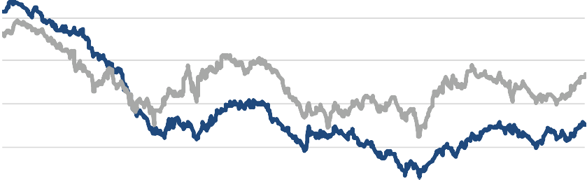



Oil’s Fall Just “Transitory?”
December 2014 – Janet Yellen first makes mention of the “transitory” nature of the fall on oil on inflation
This is true with one caveat, if it starts to effect inflation expectations
Alejandro Badel and Joseph McGillicuddy of the Federal Reserve showed a significant change in correlations of oil prices and breakeven inflation
expectations
From 2003-2015: .13
From 2008-2015: .80
From 2014-2015: .92
Oil Prices and Five Year Inflation Expectations
Price(USD) |
WTI Oil
Percentage (%)
Five Year Inflation Expectations
120
2.50
100
2.00
80
1.50
60
1.00
40
20
0.50
0
0.00
Source: Federal Reserve Bank of St. Louis (FRED)

Slide 10
Oil Price Extrapolation
Current WTI forecasts are calling for average 2018 price of
$56/barrel
We are calling for 2021 at average price of $65/barrel¹
Oil Forecasts
Price/Barrel (USD)
$100
$80
$60
Permanent 10% rise in oil prices will reflect in a 25 bps increase in one year expected inflation targets (Darvas and Hüttl)²
$40
$20
$0
Dec 2016
June 2017
Dec 2017 June 2018
Dec 2018
Source: Wall Street Journal October Forecast Compilation
Based on current 2018 oil projections and our long term 2021 projection for oil, reaching the FOMC target is easily achievable
Headline PCE will rise with the price of oil and overtake the divergence from Core PCE
¹ and ² please see Appendix A for more detail

Slide 11


















Unemployment Forecast
We currently observe unemployment to be at 4.9%, the apparent natural rate of unemployment
We are forecasting headline unemployment to decline at a slow pace going forward
Unemployment in January 2017 to be 4.7%, and 4.6% by January 2018
Unemployment Rate
Unemployment Rate (%)
UNRATE UP
12%
DOWN
FED
PROJ
10%
8%
6%
4%
2%
0%
Source: Federal Reserve Bank of St. Louis (FRED), WSJ October Forecasts, Team Projections

Slide 12
Shrinkage of the Labor Force
We currently observe the labor force participation rate to be at 62.9%
Has been in decline since the 2000s and a steeper decline since 2008
Labor force is shrinking faster than the population is growing
Projected to fall to 60.9% by 2024
Labor Force Participation Rate
Participation Rate (%)
68.0
67.0
66.0
65.0
64.0
63.0
62.0
61.0
60.0
59.0
Jan-00
Jan-01 Jan-02 Jan-03
Jan-04 Jan-05 Jan-06 Jan-07
Jan-08 Jan-09 Jan-10 Jan-11 Jan-12 Jan-13 Jan-14
Jan-15 Jan-16
Source: Bureau of Labor Statistics, Team Projections

Slide 13













The Exodus
The labor force between 2008 and 2015 stayed roughly constant
Demonstrates that the new entries were counteracted by those leaving
The population not in the labor force continued to rise through the time frame
There is available skilled labor in the form of discouraged workers
Labor Force & Not In Labor Force
Labor Force Participants | Non Labor Force Particpants
Labor Force Not in Labor Force
165,000 100,000
160,000
95,000
155,000
90,000
150,000
85,000
145,000
80,000
75,000
140,000
70,000
135,000
65,000
130,000
60,000
Source: Bureau of Labor Statistics, Team Projections

Slide 14
Freefall Due to Extreme Factors
The number of discouraged workers has fallen significantly since the onset of the crisis
Left the workforce since constant labor force numbers
Core youth generation is the growth factor for employment numbers
Baby boomers are beginning to retire en masse from the workforce
Most students are going to college to further expand skill sets
Discouraged Workers
Number of Workers (Thousands)
1400
1200
1000
800
600
400
200
0
BLS Employment-Population Ratio
Ages 25-54
84
82
80
78
76
74
72
70
Source: Bureau of Labor Statistics, Team Projections

Slide 15
Steady Growth
Non Farm Payroll
Change YoY (%)
3%
In August, we saw Non Farm Payrolls grow by 151,000 jobs, short of the 180,000 target
August is traditionally a volatile month
Jobs have been growing at roughly 2% per year since the recovery
Steady 2% growth in average hourly earnings shows high demand for jobs
Employers need to raise wages to entice candidates
2%
1%
0%
-1%
-2%
-3%
-4%
-5%
-6%
Average Hourly Earnings
Change YOY (%)
4%
4%
3%
3%
2%
2%
1%
1%
0%
Mar-07 Mar-08 Mar-09 Mar-10 Mar-11 Mar-12 Mar-13 Mar-14 Mar-15 Mar-16
Source: Bureau of Labor Statistics, Team Projections

Slide 16
GDP Forecast
GDP affected by:
Gross Private Investment
Household Consumption
Net Exports
Government Purchases
Real Gross Domestic Product
Percent Growth (%)
We are forecasting GDP growth to weaken, 2.1%, in 2016 while strengthening in the long term, 3.0%
0.05
0.04
0.03
0.02
0.01
0
-0.01
-0.02
-0.03
-0.04
2000 2001 2002 2003 2004 2005 2006 2007 2008 2009 2010 2011 2012 2013 2014 2015 2016 2017 2018

Slide 17
Low Oil Holding Us Back
Low oil has squeezed spending in energy sector therefore reducing Gross Private Investment
Remain low for remainder of 2016 amid uncertainty
Rebound in 2017 due to oil stabilizing at $65/barrel and post election uncertainty
Manufacturers' New Orders: Nondefense Capital Goods Excluding Aircraft
New Orders (Millions – USD)
Manufacturers' New Orders: Nondefense Capital Goods Excluding Aircraft
New Orders (Millions – USD)
80,000
70,000
60,000
72,000
70,000
68,000
66,000
50,000
40,000
30,000
20,000
10,000
64,000
62,000
60,000
58,000
56,000
0
Jan-13
Mar-13 May-13 Jul-13 Sep-13 Nov-13 Jan-14 Mar-14 May-14 Jul-14 Sep-14 Nov-14 Jan-15 Mar-15 May-15 Jul-15 Sep-15 Nov-15 Jan-16 Mar-16 May-16 Jul-16

Slide 18
New Generation - New Values
Shift in housing preference from baby boomers to millennials
Millennials not rushing to buy single family homes
Baby boomers moving into retirement homes
Strong employment and wage growth has spurred this demand
Multi-Family Construction Multi-Family vs. Single Family Housing Starts
Number of Permits
Multi-Family Starts |
Multi-Family
Single Family Starts (Thousands)
Single Family
500,000
450,000
Number of Starts Number of Completions Number of Permits
450,000 2,500.0
400,000
400,000
350,000
2,000.0
350,000
300,000
300,000
250,000
1,500.0
250,000
200,000
150,000
200,000
1,000.0
150,000
100,000
100,000
500.0
50,000
50,000
0
0
0.0
2000
2001
2002
2003
2004
2005
2006
2007
2008
2009
2010
2011
2012
2013
2014
2015

Slide 19
Savings vs. Spending
Baby boomers are putting more into savings for retirement
Student loans are growing very fast which is hampering spending
Mortgages vs Student Loans Outstanding
Student Loans (Millions - USD) | Mortgages (Millions - USD)
Student Loans Mortgage Debt
Savings vs Investment
Billions (USD)
Gross Private Domestic Investment
1,200,000
16,000,000
Gross Private Savings
4,000
1,000,000
14,000,000
3,500
800,000
12,000,000
3,000
 |  | 10,000,000 | 2,500
600,000 |  | 8,000,000 | 2,000
400,000
6,000,000
1,500
200,000
4,000,000
1,000
2,000,000
500
0
Jan-00
Dec-00 Nov-01 Oct-02 Sep-03 Aug-04 Jul-05 Jun-06 May-07 Apr-08 Mar-09 Feb-10 Jan-11 Dec-11 Nov-12 Oct-13 Sep-14 Aug-15
0
0
Jan-00
Oct-00 Jul-01 Apr-02 Jan-03 Oct-03 Jul-04 Apr-05 Jan-06 Oct-06 Jul-07 Apr-08 Jan-09 Oct-09 Jul-10 Apr-11 Jan-12 Oct-12 Jul-13 Apr-14 Jan-15 Oct-15

Slide 20
Strong Momentum in the Consumer
Consumer spending accounts for nearly two-thirds of economic activity
Strong multi-family home sales leads to higher disposable income
Full employment & continued wage growth also assist in consumer spending
Real Personal Consumption Expenditures
Percent Growth (%)
8.0
6.0
4.0
2.0
0.0
-2.0
-4.0
-6.0
2000
2001
2002
2003
2004
2005
2006
2007
2008
2009
2010
2011
2012
2013
2014
2015
2016

Slide 21
Trade & Government Spending
Expect trade gap to widen
Continued domestic momentum driving growth in imports
Exports remain constrained by strong dollar and sluggish foreign demand from slowdown in emerging markets
According to the CBO nearly $10 trillion will be added to the debt over the next 10 years
Both candidates will increase spending and neither has a plan in place to balance budgets
Trade Gap
USD (in Millions)
Exports of goods and services
Federal Government: Current Expenditures
Percentage Change (%)
800,000
Imports of goods and services
10.00%
8.00%
600,000
6.00%
400,000
4.00%
200,000
2.00%
0
0.00%
Jan-99
Jan-00
Jan-01
Jan-02
Jan-03
Jan-04
Jan-05
Jan-06
Jan-07
Jan-08
Jan-09
Jan-10
Jan-11
Jan-12
Jan-13
Jan-14
Jan-15
Jan-16
-2.00%
2000
2002
2004
2006
2008
2010
2012
2014

Slide 22
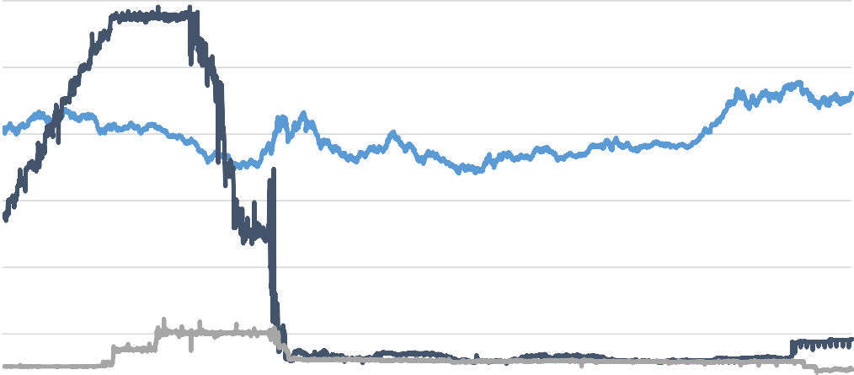
Risks
Political Risk – Fiscal Policy hinging on November Elections?
US Dollar Strength/Appreciation
Widening of Global Central Bank Policy
Increase in Oil Price means appreciated United States Dollar
US oil production spike (Horizontal Shale Drilling)
USD vs. Central Bank Policy
Dollar Index | Central Bank Rate (%)
Trade Weighted Dollar Index Effective Fed Funds Rate
BOJ Overnight Rate
120 5.50
100
4.50
80
3.50
60
2.50
40
1.50
20
0.50
0
Jan-05 Jan-06 Jan-07 Jan-08 Jan-09
-0.50
Jan-10 Jan-11 Jan-12 Jan-13 Jan-14 Jan-15 Jan-16
Source: Federal Reserve Bank of St. Louis (FRED), BOJ Statistical Database

Slide 23


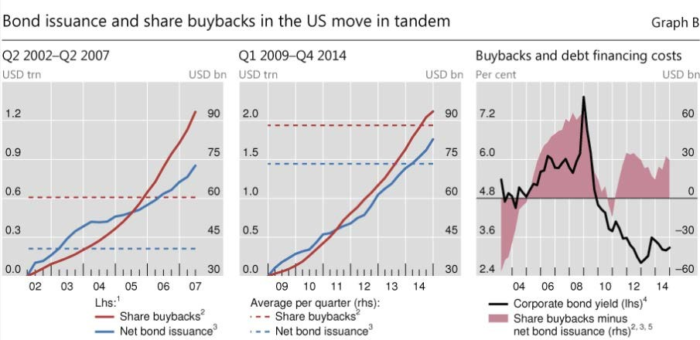





What Else Is Going On…
Low interest rates have provided cheap financing for corporates
Companies have issued bonds to buyback shares on the market, creating overvaluation
Large scale M&A activity due to near-zero rates on financing
Chemical, retail, technology
Source: Bureau of Labor Statistics, Team Projections

Slide 24
Policy Recommendation
We believe the Federal Reserve should increase the Fed Funds Rate by
150 bps in increments of 25 bps throughout 2017 & 2018
As oil stabilizes towards $65/barrel:
Gross private investment should increase therefore strengthening GDP growth
Core inflation should rise towards 2% target level
Increasing employment in the 25 – 54 year old bracket with wage growth demonstrates the strong demand for US workers
Increased overvaluation and decreasing competition is hurting the economy
Raising rates in 2017 will allow the Federal Reserve to satisfy the Dual Mandate
Source: Bureau of Labor Statistics, Team Projections

Slide 25
Federal Reserve Challenge NY 2016
Thomas Flannery Ronak Shah Timothy Leahey

Slide 26
Appendix A

Slide 27
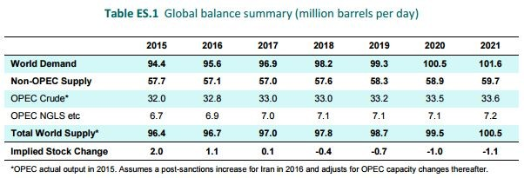


Oil Price Extrapolation
Current WTI forecasts are calling for average 2018 price of $56/barrel
¹ We are calling for 2021 average price of $65/barrell
Potential short term support due to OPEC production talks
Lack of counter-cyclical investment will provide long term supply challenges
² Permanent 10% rise in oil prices will reflect in a 25 bps increase in one year expected inflation targets (Darvas and Hüttl)
Economists from European Research Group Bruegel
Short term volatility – 9 bps in longer, permanent five year expectations
Crude up 4.3% since end of September already
Source: EIA September 2016 Global Report
27

